Slide 1

FHIR
HIMSS
2015
Notes:
Introduction to FHIR

Slide 2

FHIR
FHIR : Fast Healthcare Interoperability Resources (Pronounced “Fire”)
The hottest thing interoperability this year
Insert other jokes here…
Based on industry best practices, with a focus on simplicity and implementability

Slide 3
Healthcare Standards
Complex…. Slow…
Hard to use and understand
Require specialist skills, tools
Costly

Slide 4
Healthcare Standards
Complex…. Slow…
Hard to use and understand
Require specialist skills, tools
Costly
What if it didn’t have to be like that?

Slide 5
REST & Resources
REST: a pattern for using web technologies to manage information
Resources: the building blocks that get exchanged
Like web pages, but for computer usage
Scalable – performance, and community

Slide 6
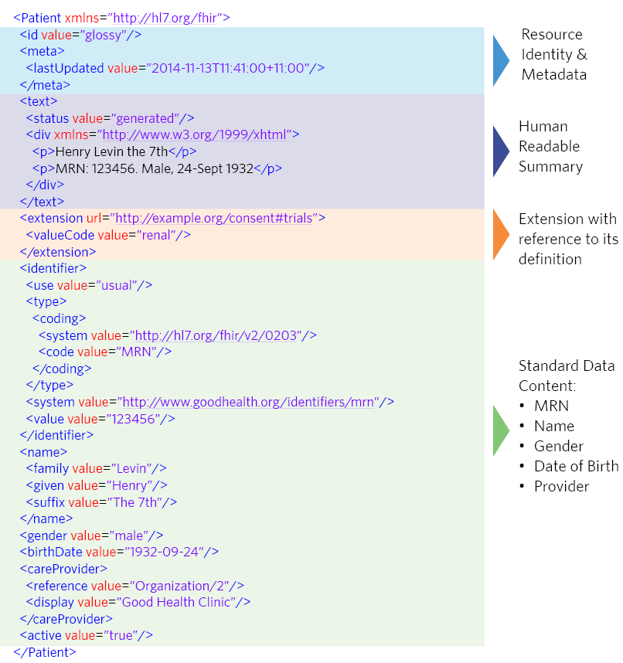

Slide 7
Kinds of Resources
Clinical Concepts
Allergy, Problem, Family History, Care Plan
Medication Management
Administrative Concepts
Person, Patient, Organization, Device, Facility
Infrastructure Functionality
Document, Message, Conformance/Profiling
Financial Management
Claims / Reimbursement, Contract

Slide 8
Using Resources
Classic Web RESTful approach
Simple approach led by Facebook, Twitter, etc.
Documents / Messages
Same deployment as HL7 v2 / CDA
But common technical base
Services (SOA)
Fit into existing enterprise architectures
Portability – common structures everywhere

Slide 9
Extensions
Managing extensibility is a central problem
Everyone needs extensions, everyone hates them
FHIR tames extensibility
Built in extensibility framework (engineering level)
Define, publish, find extensions
Use them
This tames the overall specification

Slide 10
FHIR Ethos
Simplicity / Web alignment
Implementation focused
Reference Implementations (C#, Java, etc)
Publically available test servers (now)
Connectathons
Freely available
http://hl7.org/fhir
Creative Commons Public Domain

Slide 11
Status
1st DSTU published Feb 3rd 2014
(Draft Standard for Trial Use)
Widespread Community Growth and Adoption
2nd DSTU open for final ballot now
Changed based on implementer feedback
Expect to publish July/August

Slide 12
2nd DSTU Key Changes
API
Simplify collections / transactions
Significant enhancements to search
Introspection
Massive upgrade to capabilities
Domain Resources
Simplification, enhancements
X new resources (all modules)

Slide 13
FHIR & CCDA
CCDA is mandated by Meaningful Use
FHIR is a new specification
FHIR is not a replacement for CCDA (yet)
Project to migrate CCDA content to FHIR
Future: CCDA ←→ FHIR interchange projects
Document and data exchange will continue to co-exist

Slide 14
Key FHIR Projects
SMART
Key integration framework for many uses of FHIR
Argonaut
JASON Taskforce – API based access to data
Patient / Provider portals, data exchange
HSPC
API based access to data
EHR plug-in framework

Slide 15
Follow Up
Read the spec: http://hl7.org/fhir
Follow #FHIR on Twitter
Become part of the community:
Come to a Connectathon!
Make comments online
Join the FHIR email list http://wiki.hl7.org/index.php?title=FHIR_email_list_subscription_instructions
Implement it
Come to the next meeting (Paris in May)

Slide 16
FHIR
Simple…. FAST…
Easy to use and understand
Standard skills, tools
Cost-effective information sharing

